Slide 1
User Personas
Understanding how buyers, renters, and investors discover and secure properties
Domain: Digital Real Estate Platform — Housing.com
UI/UX Design — User Personas | Nancy Kathiriya | PRN: 1262242543 | Roll No: 13 | Panel: F

Slide 2
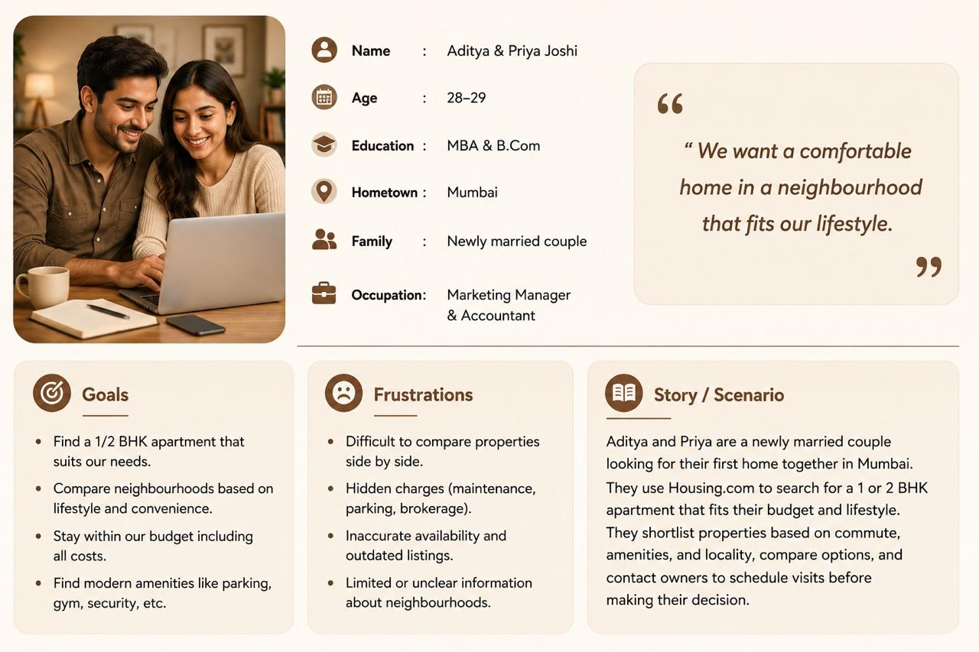
01.

Slide 3
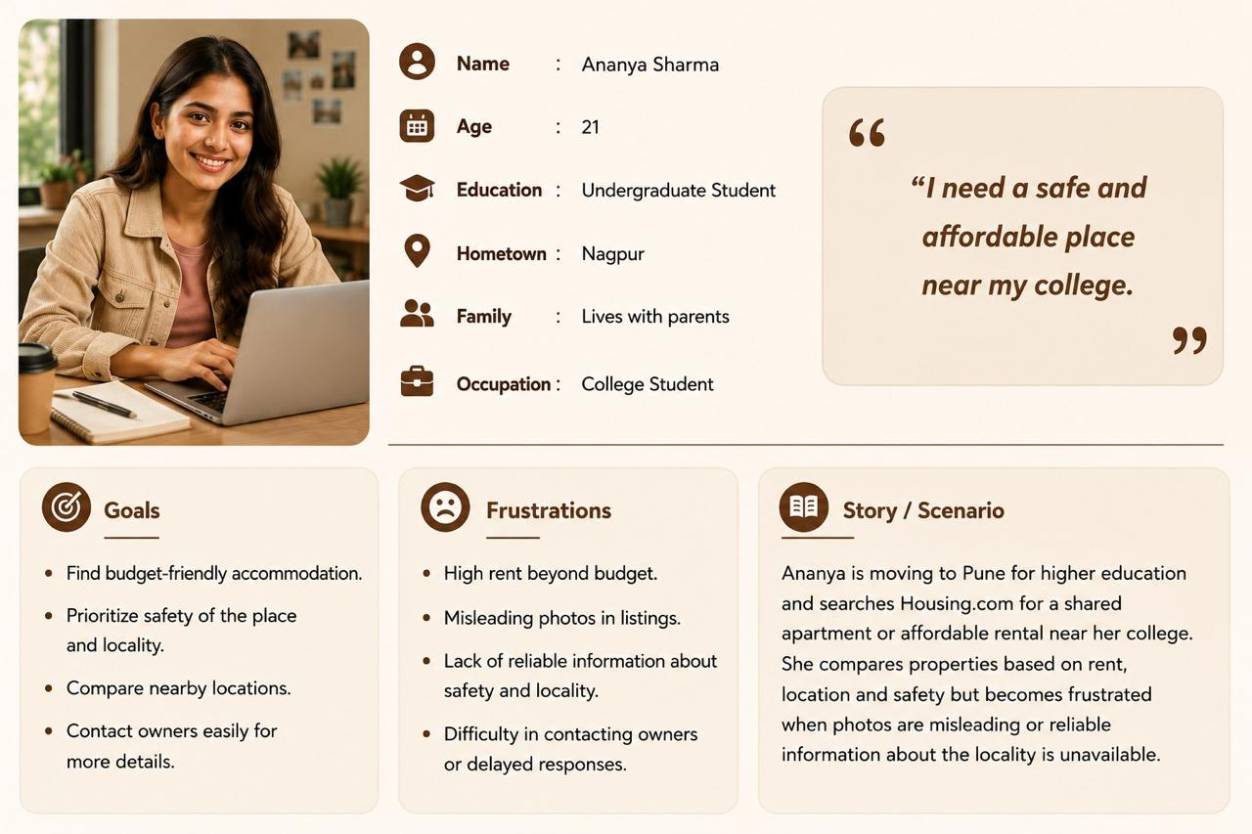
02.

Slide 4
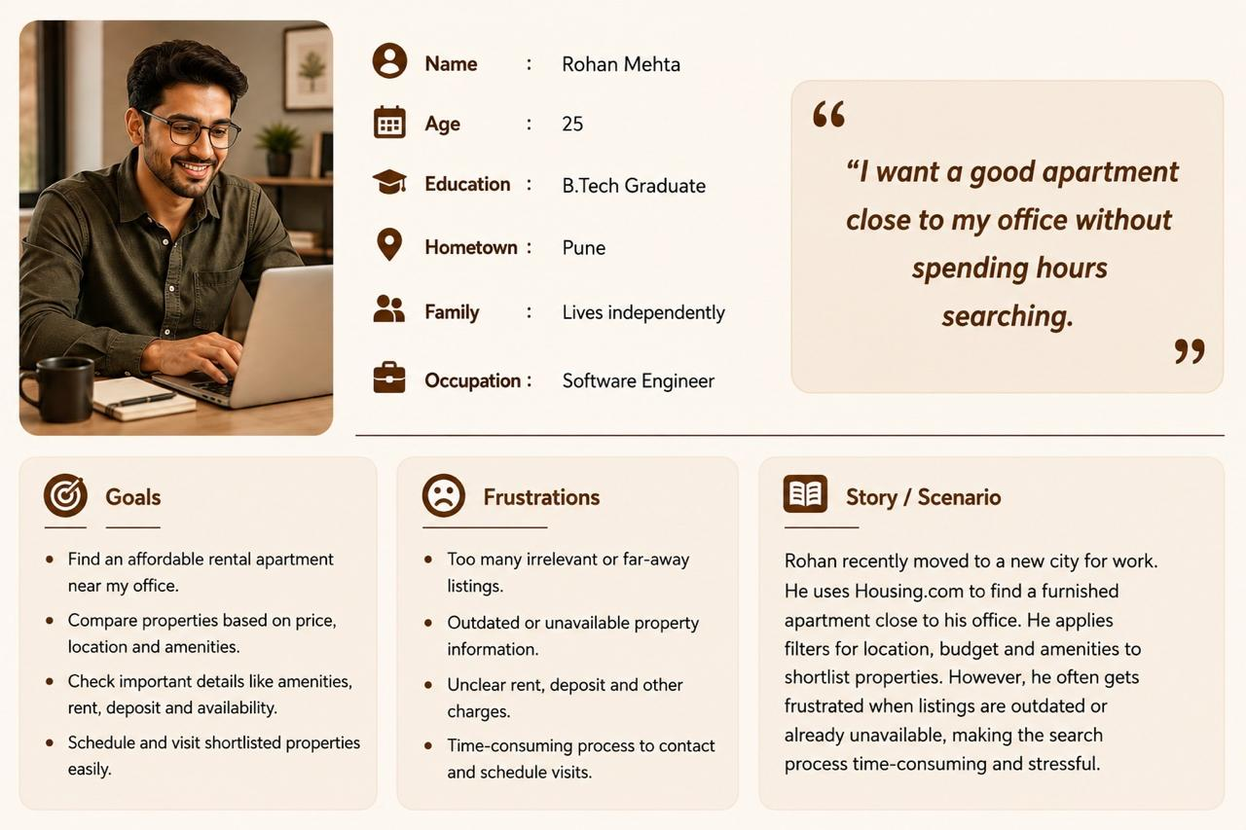
03.

Slide 5
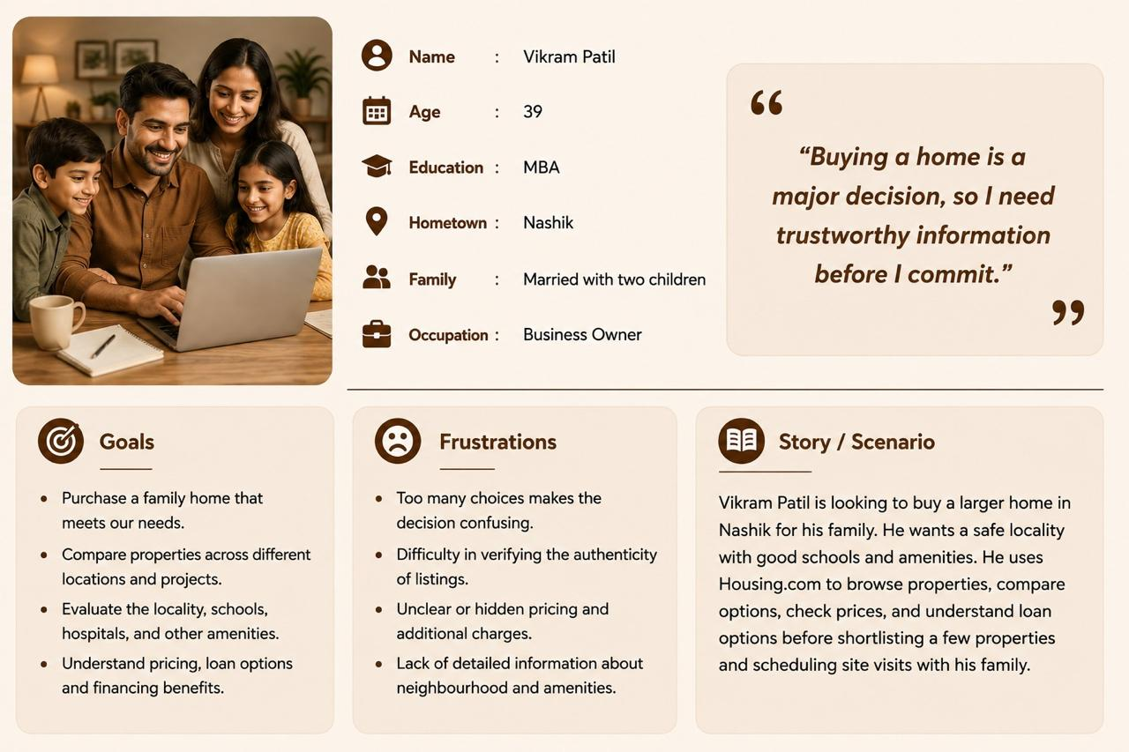
04.

Slide 6
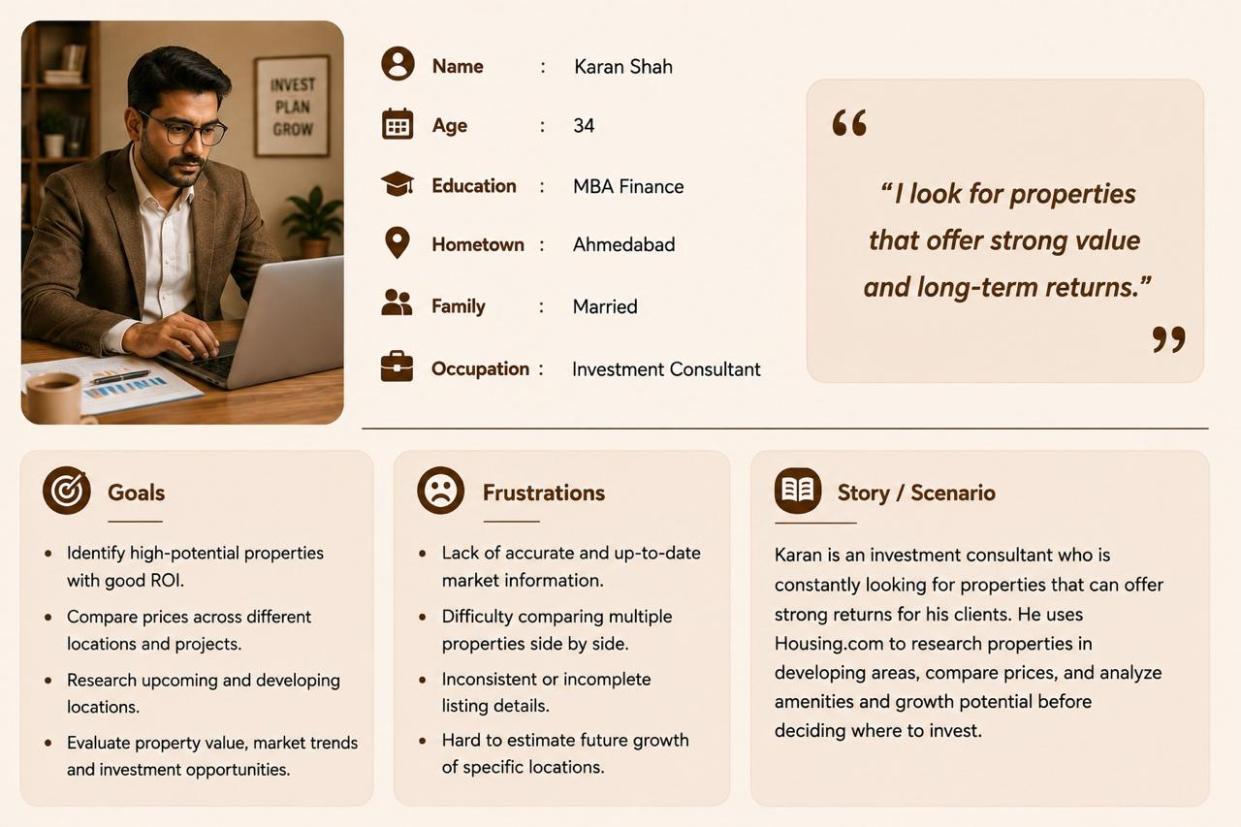
05.

Slide 7
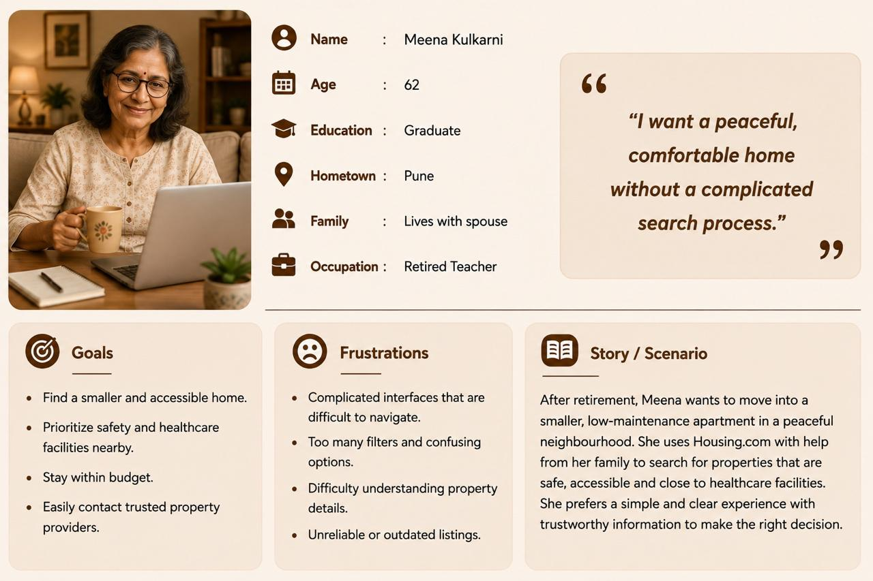
06.

Slide 8
User Journey Maps
Mapping the Path from First Click to Final Move.

Slide 9
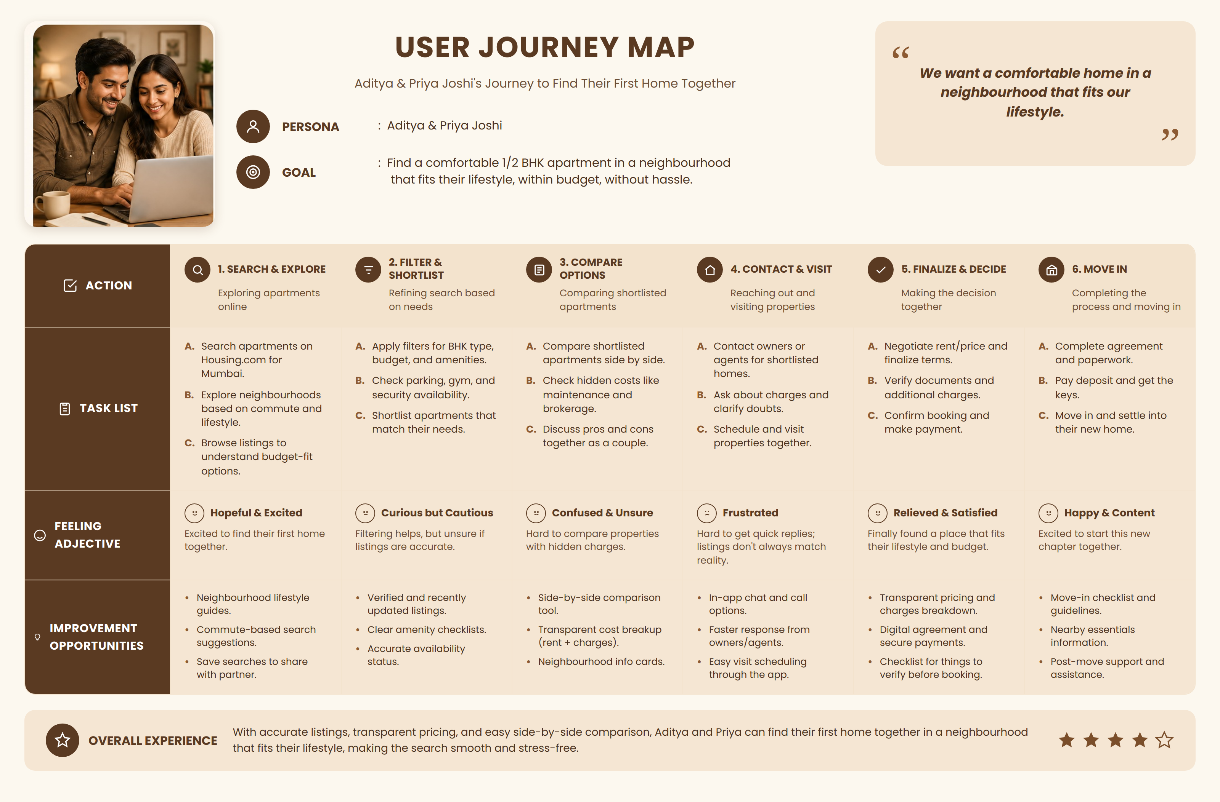
01.

Slide 10
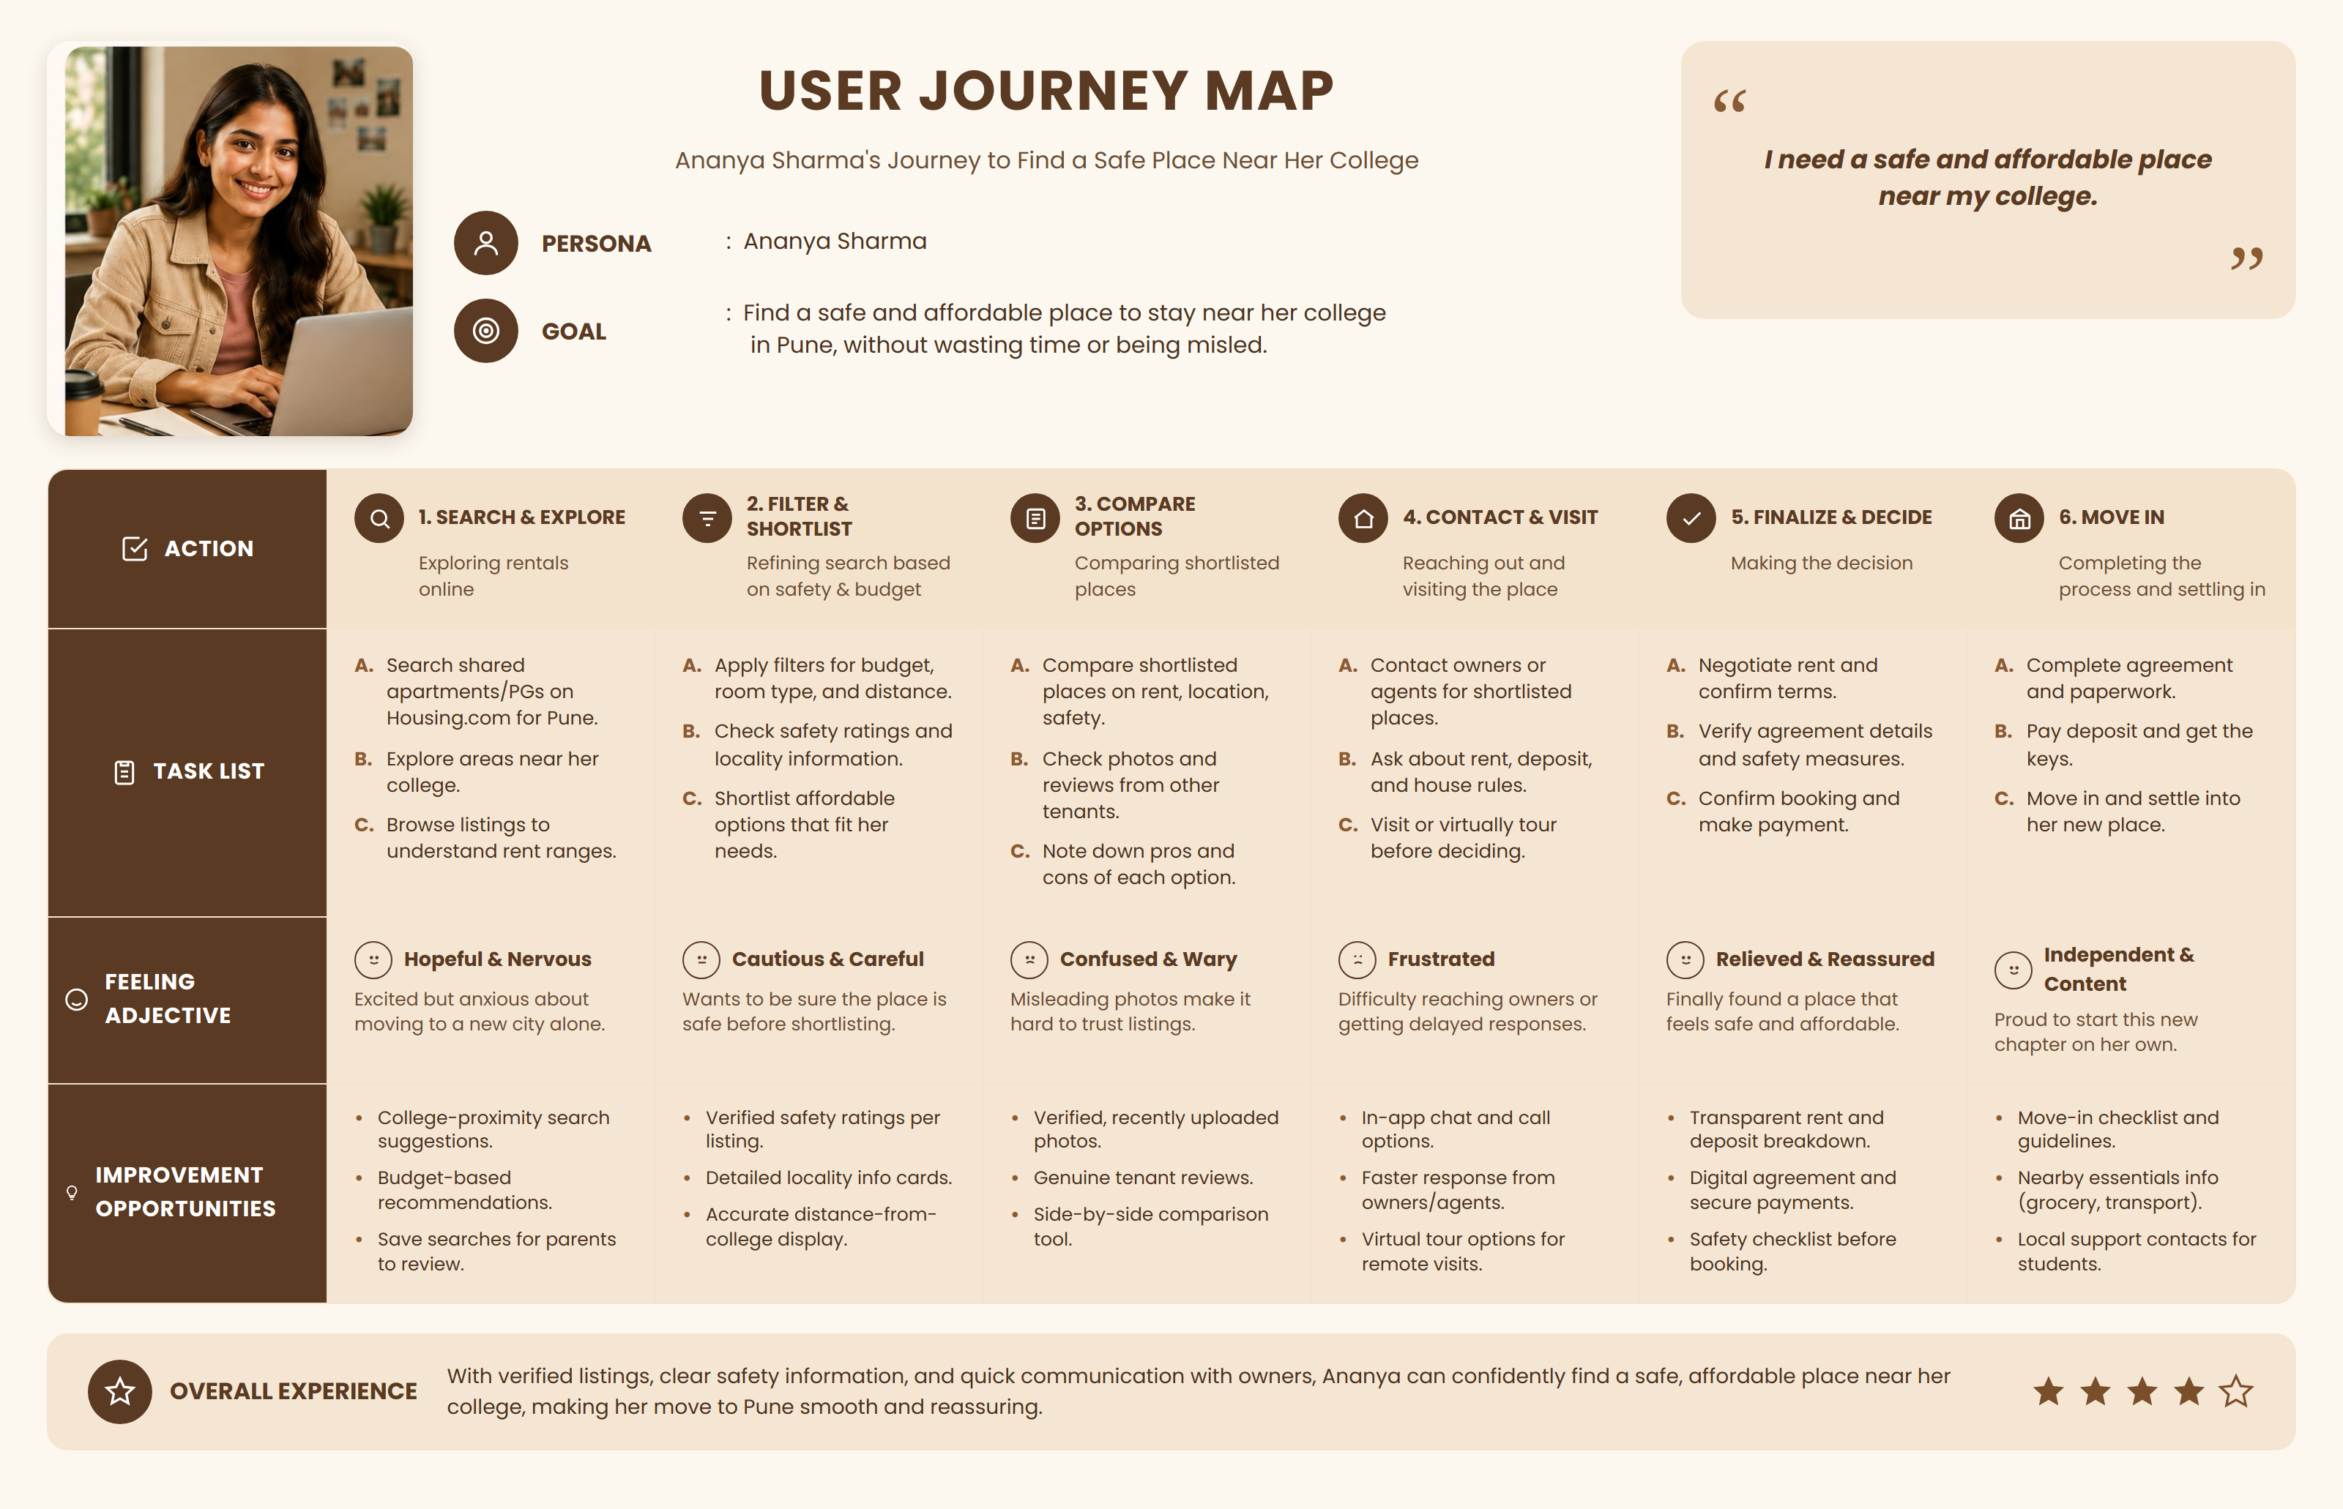
02.

Slide 11
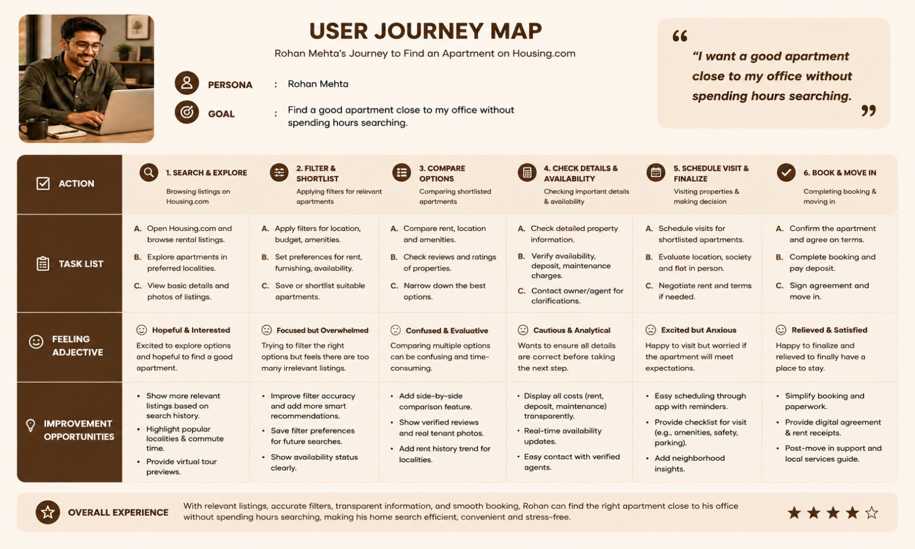
03.

Slide 12
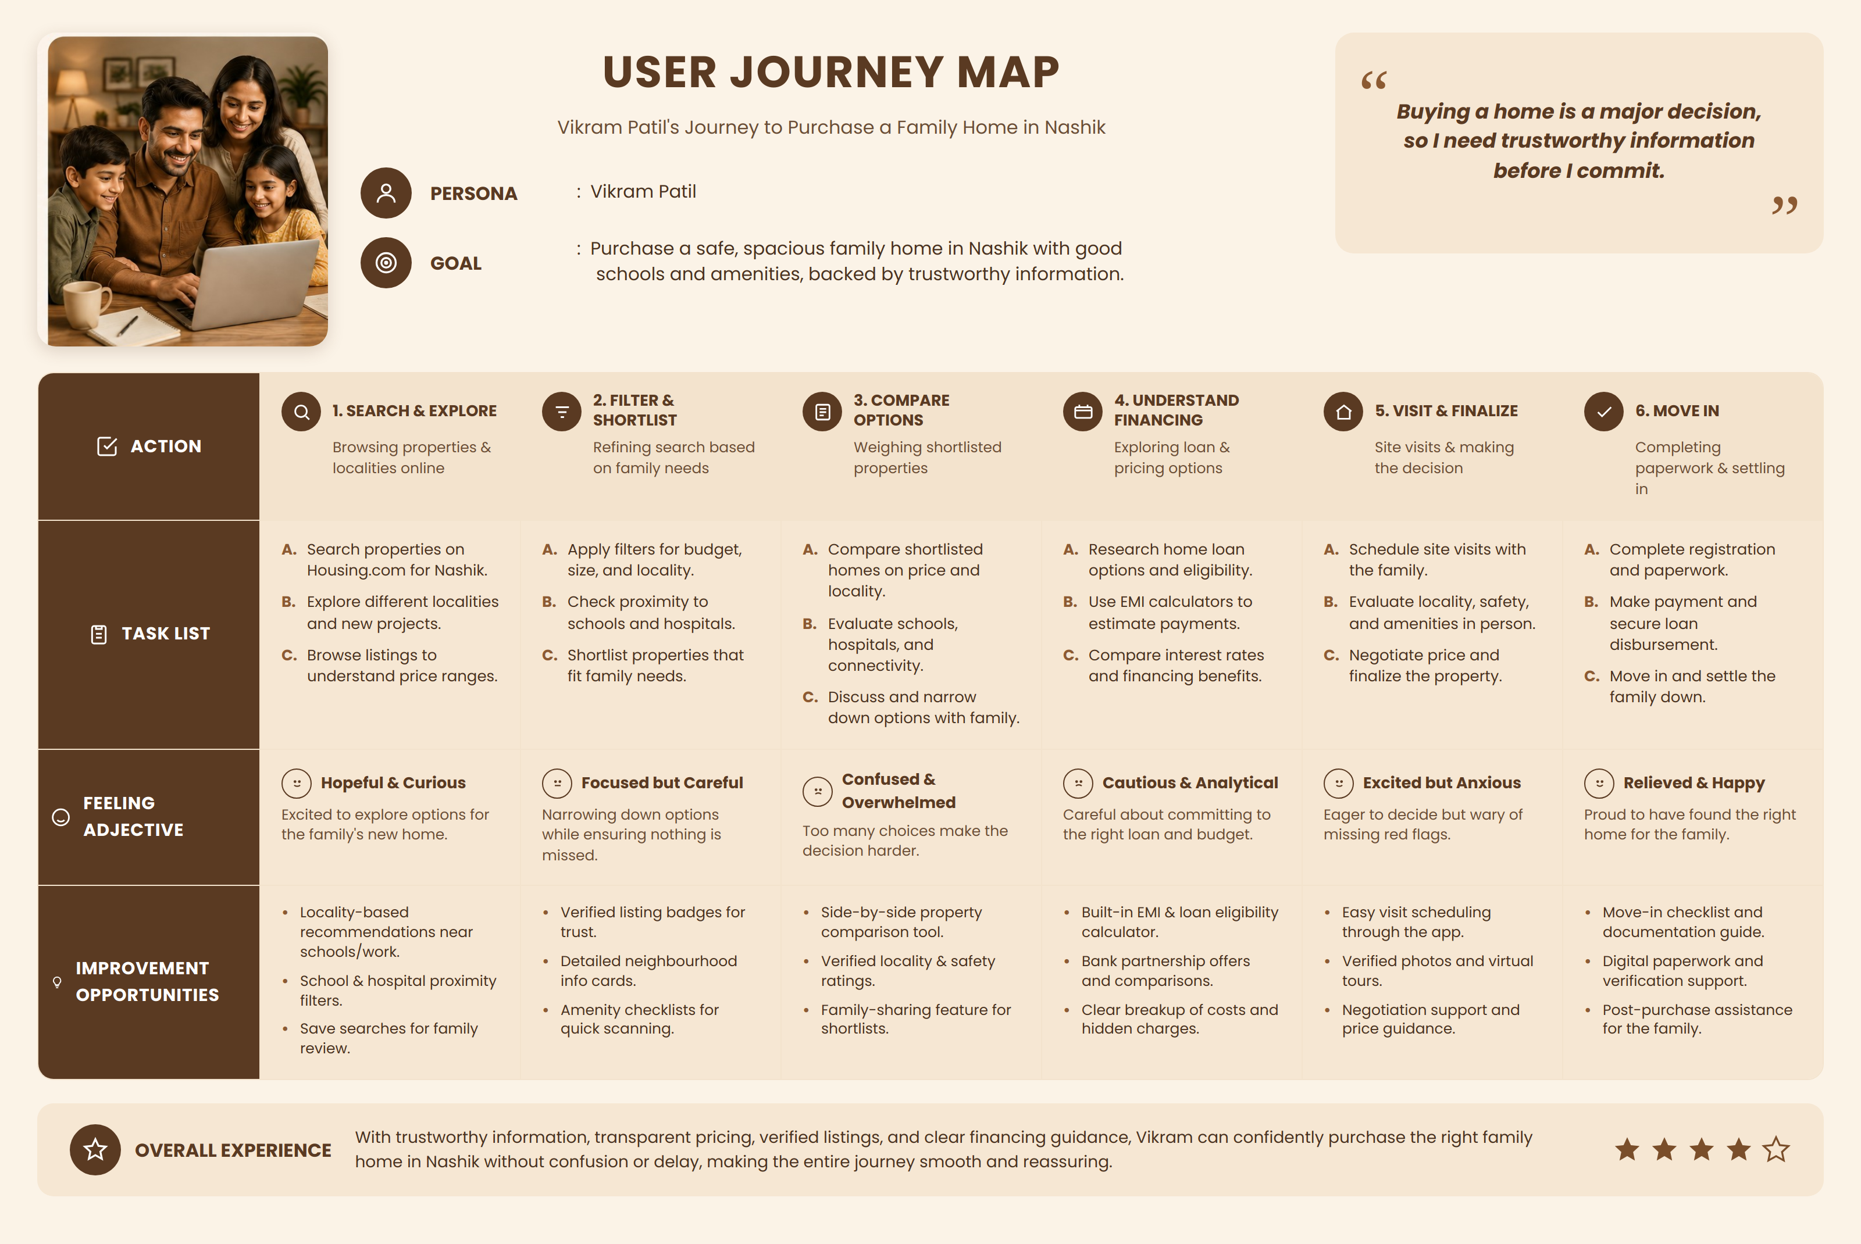
04.

Slide 13
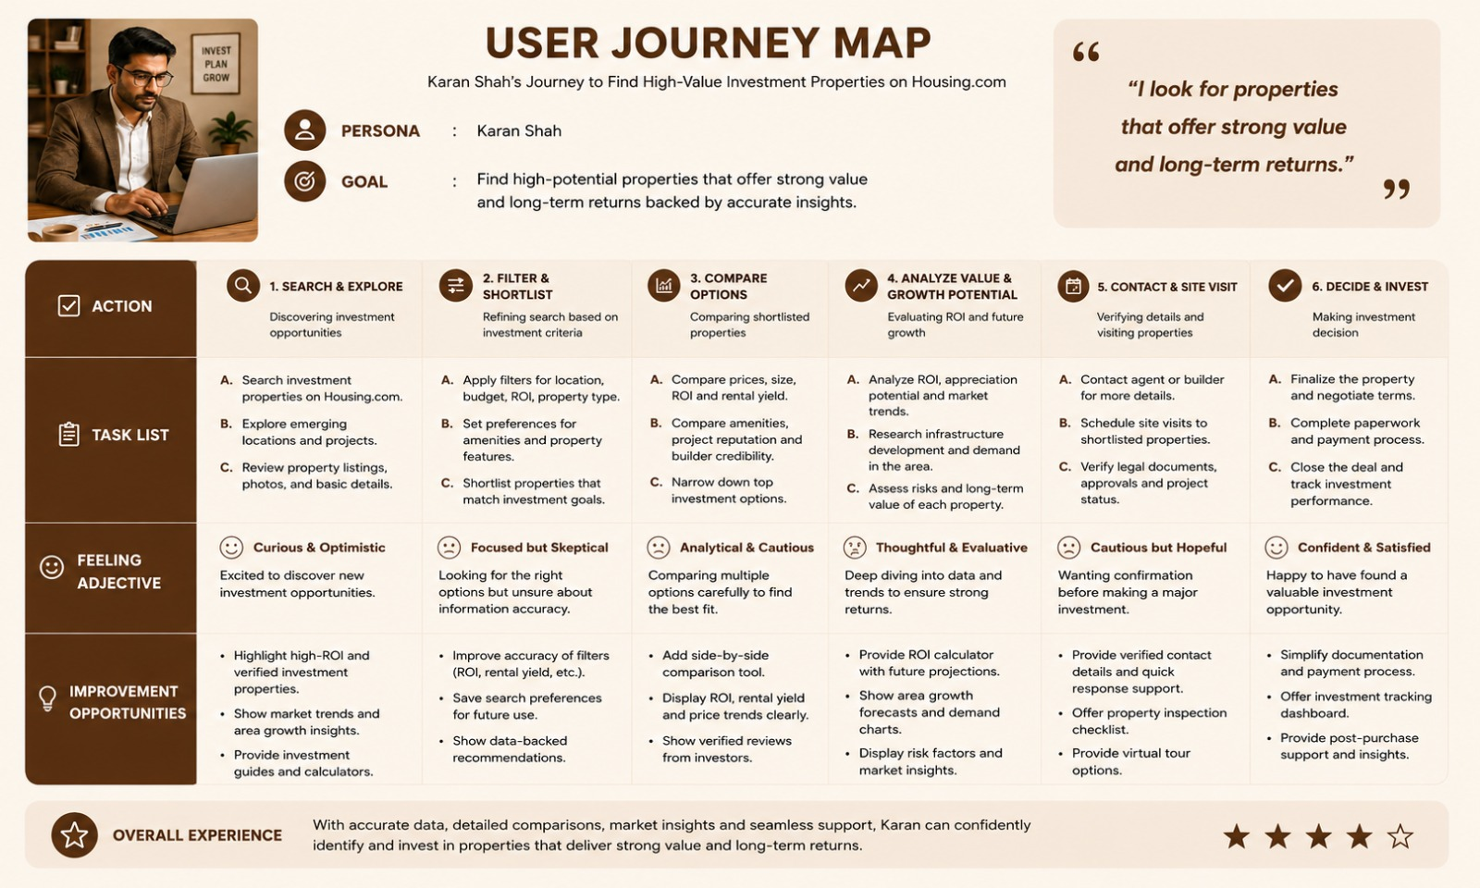
05.

Slide 14
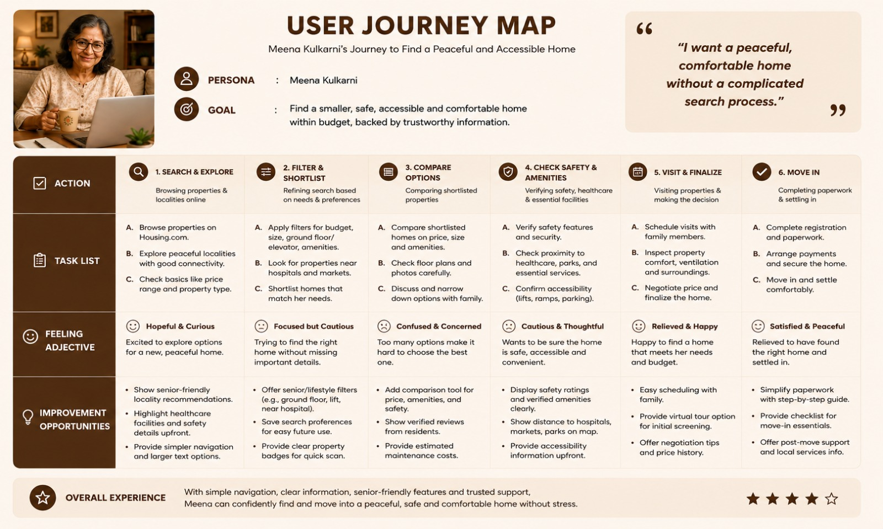
06.

Slide 15

RESEARCH GAP ANALYSIS
The analysis of existing real-estate platforms shows that, although websites provide a large amount of property information, users may still face difficulties in finding relevant properties, comparing multiple options, understanding important details, and making confident decisions. Information is often distributed across different sections, while filters, navigation, property details, and comparison features may not always align with the way users naturally search for a property.
There is therefore a gap in creating a more user-centered, simple, and consistent real-estate interface that reduces information overload and supports users throughout the property-search process. A better design could focus on simplified navigation, meaningful filters, clear property information, easy comparison, transparent pricing, and personalized recommendations.
The research will explore how UI/UX improvements can make the real-estate search experience more efficient, understandable, accessible, and decision-oriented for users.

